Slide 1
Current State of Ethereum Proof-of-Stake
By
Shreeja Mithinti

Slide 2
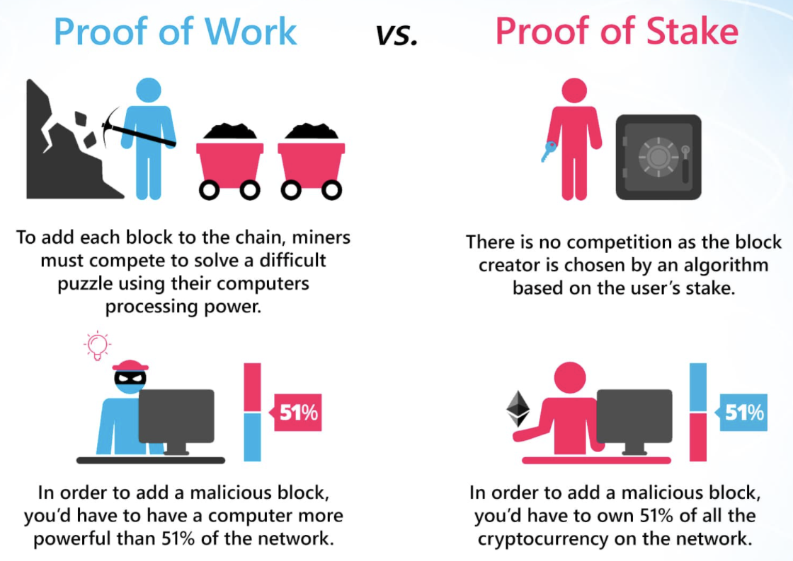
Ethereum 1.0 vs Ethereum 2.0 (Serenity)
Ethereum 1.0
Proof-of-Work
Miners – solve complex puzzle
A single Blockchain with consecutive blocks
Ethereum 2.0 (Serenity)
Proof-of-Stake
Validators – stake Eth
Blockchain splits into shard chains

Slide 3
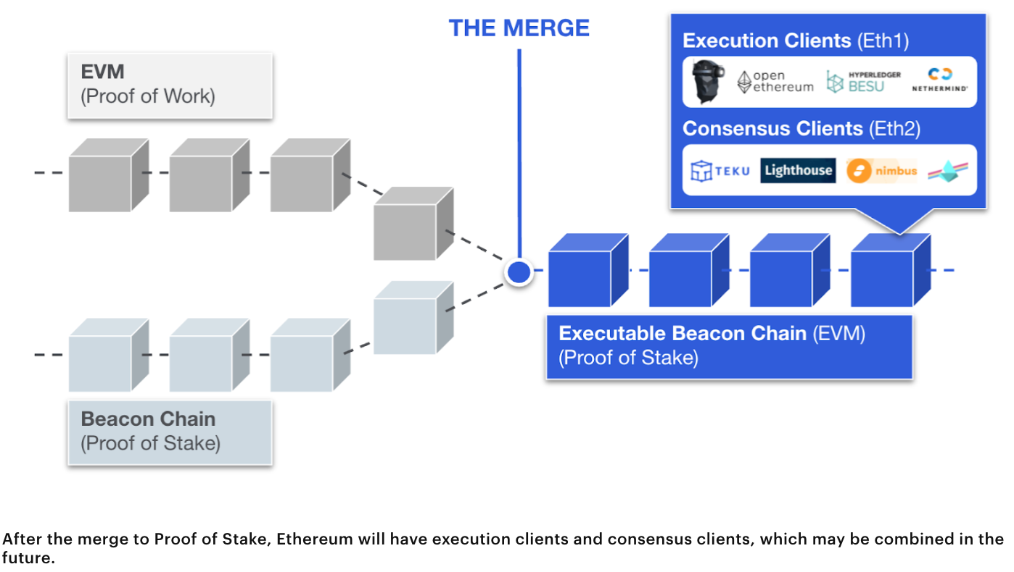
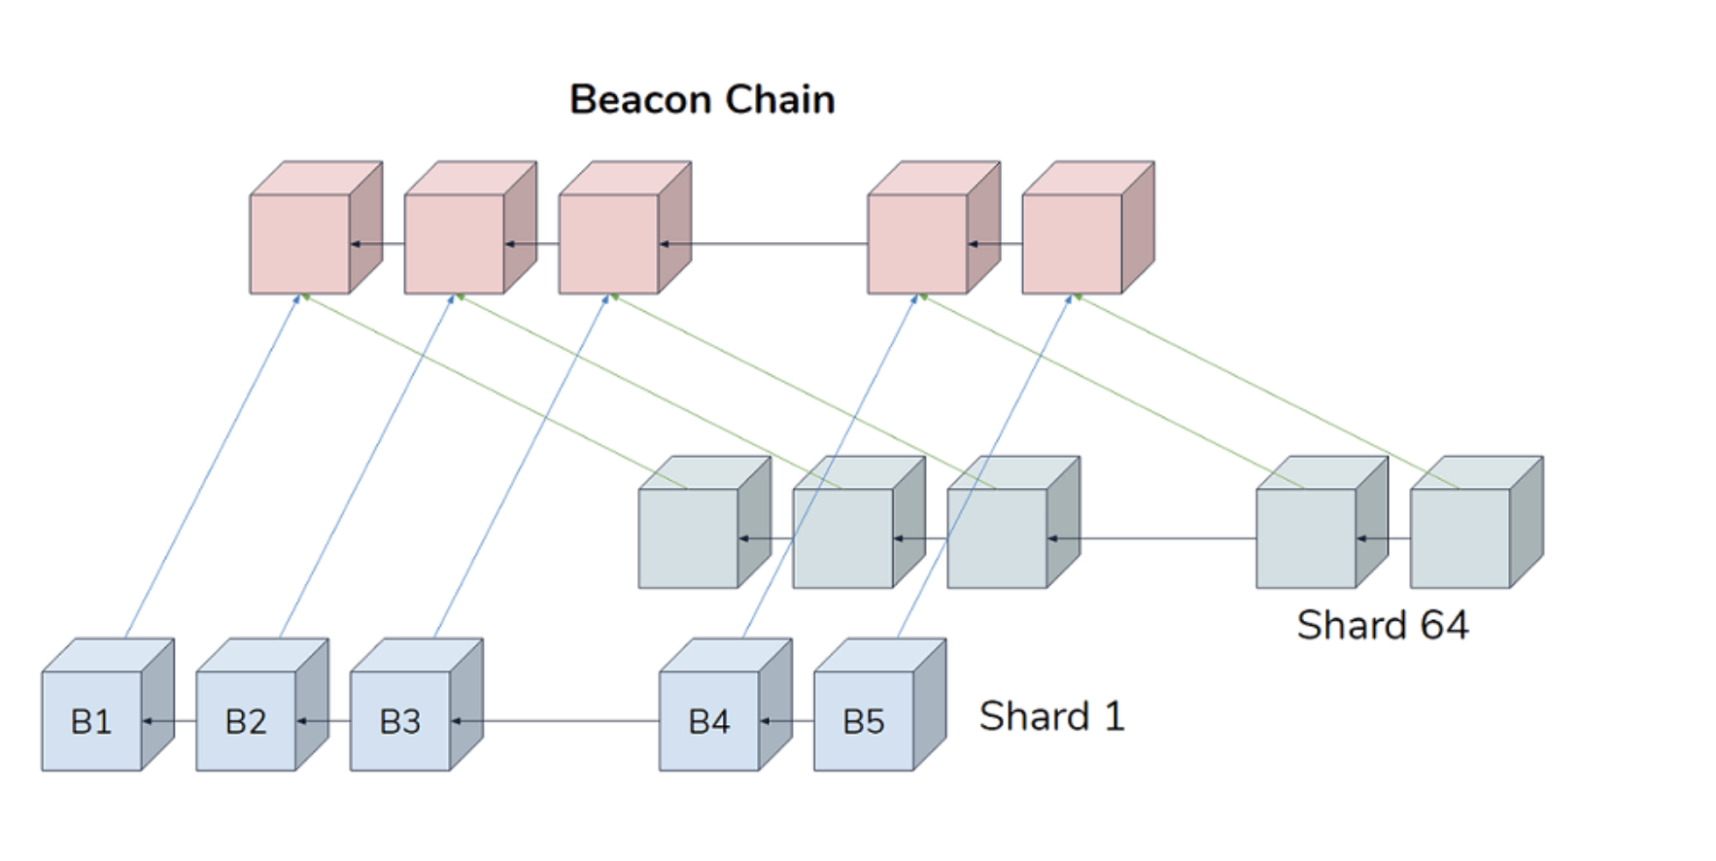
The Merge – Ethereum 2.0
Proof-of-Stake
Phase 0: The Beacon Chain introduced proof-of-stake to the Ethereum system.
Phase 1: Current Ethereum Main network will merge with the beacon chain (PoS).
Phase 2: The next upgrade will introduce shard chains to the proof-of-stake network
Sharding improves Ethereum’s scalability and capacity

Slide 4
Proof-of-Stake
Contd.
Stake Eth to become validator
32Eth – 100,000$ approx. to join a staking pool
Chosen randomly
Validator Responsibilities :
validating shards, transactions
adding new blocks
Validation Process
Attestation
Crosslinks
Finality

Slide 5
Advantages
 | PoW | PoS
Energy consumption | Very high | low
Hardware requirement | High | Low
Block Generation Speed | Slow | Fast
Transaction confirmation speed | Slow | Fast
Significantly reduces Ethreum’s power consumption
Higher appeal among institutional investors interested in ESG
Cut Transaction fees
Improve congestion
More Secure
More transactions

Slide 6
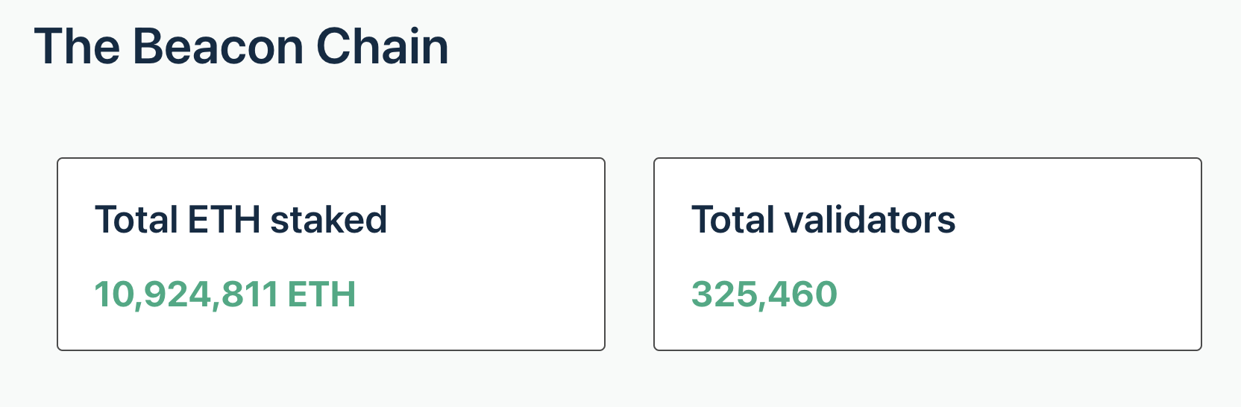
Fast Facts
Vitalik Buterin has confirmed that Ethereum will move from proof-of-work to proof-of-stake this summer.
Ethereum’s trial merge on the ‘Kiln’ testnet is successfully done on March 15th.
Between March 20 and March 27, Ethereum’s market capital has gained about $31 billion
Since Beacon chain launched , more than 10 million Ether has been staked for Ethereum 2.0.
As of March 28th, 2022

Slide 7

Risk factors
Slashing:
You lose stake when the node is offline, or you validate wrong one.
If you’re part of a pool and the service goes down, you lose the stake
Proof of stake hasn't been established on the same scale as proof-of-work platforms.
Ethereum 2.0 rollout is Time taking
In early days and Less tested
Uncertain Staking returns

Slide 8
References
https://ethereum.org/en/
https://ethereum.org/en/developers/docs/consensus-mechanisms/pos/
https://launchpad.ethereum.org/en/
https://finbold.com/over-30-billion-pumps-into-ethereums-market-cap-as-eth-outshines-bitcoin-for-the-second-week/
https://forkast.news/headlines/ethereum-closer-to-pos-after-kiln/

Slide 9
Thank You
Any Questions?

